Slide 1
School Improvement Plan
School Name
Lockheed Elementary
School Year
2022-2023

Slide 2
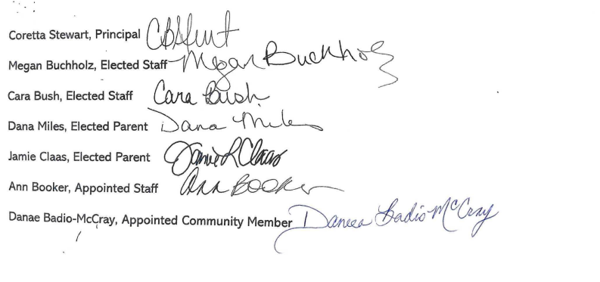
Lockheed ES
School Governance Team Members
Notes:
*Be sure to include name, title, and signatures of all stakeholders

Slide 3
School Leadership Team Members
Coretta Stewart, Principal
Ann Booker, Assistant Principal
Nicole Meador, Assistant Principal
Julianna Morelock, Instructional Coach
Emily Ovalle, Instructional Coach
Megan Buchholz, MTSS Coordinator
Pam Johnson, Kindergarten Team Leader
Cassi Culhan, 1st Grade Team Leader
Miranda Jones, 2nd Grade Team Leader
Jasmine Smith, 3rd Grade Team Leader
Lafia Holloway, 4th Grade Team Leader
Kyle Hibbler, 5th Grade Team Leader
Barbara Udall, Specials Team Leader
Rachel Morrissey, ESOL Team Leader
Sheila Hernandez, EIP Team Leader
Kevin Murchison, Special Ed Team Lead
Notes:
*Be sure to include name, title, and signatures of all stakeholders

Slide 4
Student Demographics
Percentage of Students

Slide 5
Student Programs & Enrollment

Slide 6
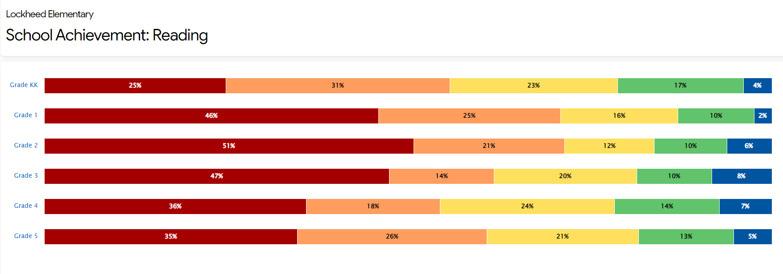
Fall 2022 MAP Assessment
Needs Assessment
Notes:
*Be sure that needs assessment is comprehensive utilizing data points to fully support your strategies and goals
*Be sure that your needs assessment takes into account different subgroups

Slide 7
Fall 2022 MAP Assessment
Needs Assessment
Notes:
*Be sure that needs assessment is comprehensive utilizing data points to fully support your strategies and goals
*Be sure that your needs assessment takes into account different subgroups

Slide 8
Georgia Milestones Results
Needs Assessment
Data shows student achievement levels on EOG for all tested students who have been enrolled in the school for the previous year, at least two years, three years, and four years.

Slide 9
Georgia Milestones Results
Needs Assessment
Data shows student achievement levels on EOG for all tested students who have been enrolled in the school for the previous year, at least two years, three years, and four years.

Slide 10
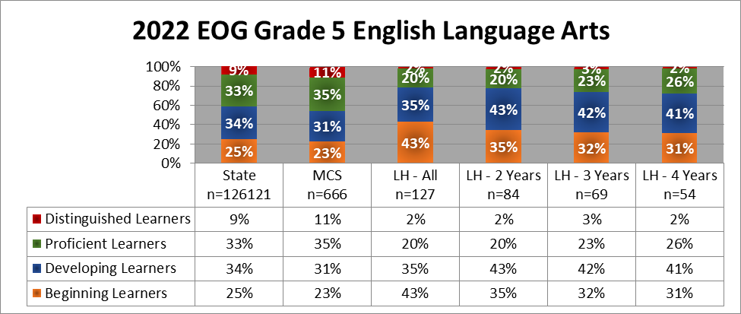
Georgia Milestones Results
Needs Assessment
Data shows student achievement levels on EOG for all tested students who have been enrolled in the school for the previous year, at least two years, three years, and four years.

Slide 11
Georgia Milestones Results
Needs Assessment
Data shows student achievement levels on EOG for all tested students who have been enrolled in the school for the previous year, at least two years, three years, and four years.

Slide 12
Georgia Milestones Results
Needs Assessment
Data shows student achievement levels on EOG for all tested students who have been enrolled in the school for the previous year, at least two years, three years, and four years.

Slide 13
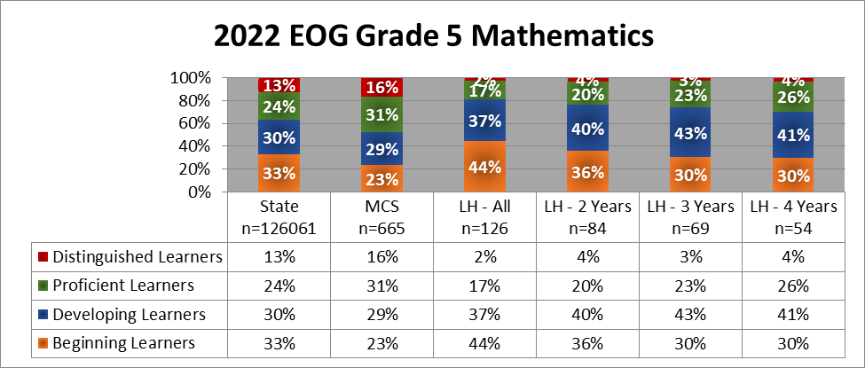
Georgia Milestones Results
Needs Assessment
Data shows student achievement levels on EOG for all tested students who have been enrolled in the school for the previous year, at least two years, three years, and four years.

Slide 14
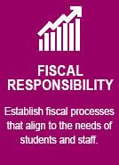
Strategic Plan:
Lockheed ES
Increase the percentage of 3rd -5TH grade students who remained enrolled for 3+ years to at or above grade level proficiency in ELA by 10%+ on the Spring EOG Assessment
Building Culture & Climate
Implement strategies that will create a positive and supportive learning environment and improves overall culture and climate
Partnerships:
Increase the number of community partnerships that support school initiatives and align to instructional goals
Transparent and Efficient
Management of Consolidated Funds
Ensure effective management
Outcomes/Goals: What will success look like for our school? (Smart Goals)
Increase the percentage of 3rd - 5TH Grade students who remain enrolled for 3+ years will perform at or above grade level proficiency in Math by 10%+ on the Spring EOG Assessment
Staff Retention
Increase the percentage of highly qualified staff who are retained for the following year
Family Engagement:
Increase the number of opportunities for families to engage in school events and parent meetings
Structured Literacy
Implement Science of Reading & literacy instructional strategies that utilizes researched based strategies to address individual student needs
Transforming School Culture
Implement Positive Behavior Interventions and Supports to create a positive and supportive environment for all stakeholders
Community Connections:
Provide multiple opportunities for school and community collaborations that support student achievement
Effective Budgeting
Refine and adjust budgeting process to ensure that all financial resources are used effectively and align to strategic plan goals and needs of students and staff
Initiatives: What will we do to achieve success?
Balanced Math Framework
Implement math instruction that helps students build the computational and conceptual skills needed to solve complex problems
Love. Learn. Lead.
Implement strategies that will support and engage all staff to increase staff retention
Parents As Partners
Provide monthly workshops, events and activities for parents to engage and collaborate

Slide 15
Initiatives: What will we do to achieve success?
Critical actions: What major actions will we complete and by when (student groups)?
Evidence of progress: How will we know that the initiative is working?
(Timeline)
Outcomes: What will success look if we provide opportunities for all children (student groups)?
Implement instructional strategies based on the Science of Reading – Top Ten Teaching Tools Modules
Provide System 44/Read 180 daily intervention instruction for identified 3rd – 5th students who performed more than one grade level below
Provide Lexia daily intervention for ELL students who scored Levels 1-3 on ACCESS 2022
Provide Tier 3 intervention support to Special Ed students using HillRap
Provide daily Benchmark Phonics instruction for all Kindergarten -3rd Grade students
Implement 95% for identified K-5 students in Tier 2 & 3
Evidence of the implementation of SOR strategies in classroom observations
MAP Reading Assessments – K-5 Increased percentage of students making progress and meeting expected growth benchmarks from Fall>Winter>Spring
Phonics Cycle Assessment Data Common Assessment Data – monthly review of data during PLC meetings
Spring ACCESS data
Increased percentage of EL students who move at least one band on ACCESS assessment
Increased percentages of students who score at/above grade level on MAP Assessments
Increased percentages of Student with Disabilities who score proficient and distinguished on Georgia Milestones ELA Assessment
Structured Literacy
Implement Guided Math instruction in small groups based on students’ assessment data.
Administer common assessments and provide small group intervention instruction based on student data for all Tier 2 students
Implement intervention resources to address math deficits - Symphony Math instruction for all Tier 3 students who scored <18% on MAP & Compass Learning (Odyssey) as Tier 1 instruction support for all students who are on level
Implement Advanced Content instruction for above level students
MAP Math Assessments - (K-5) Increased percentage of students making progress and meeting expected growth benchmarks from Fall>Winter>Spring
Monthly Common Assessment Data
Review data during PLC meetings
Symphony Math progress levels and growth
Increased percentages of students who meet/exceed grade level on MAP Math Assessment
Increased percentages of Student with Disabilities who score proficient and distinguished on Georgia Milestones Math Assessment
Balanced Math
Strategic Plan: Lockheed Elementary
15

Slide 16
Initiatives: What will we do to achieve success?
Evidence of Progress:
Impact Check #1- Fall
Evidence of Progress:
Impact Check #2- Winter
Evidence of Success:
Impact Check #3- End of Year
Fall MAP Reading - Percentage of students meeting projected growth:
1st Grade – 21% , 2nd Grade – 40%
3rd Grade – 41%, 4th Grade – 56%
5th Grade – 43%
Lexia- 92% Below to 81% Below;
8% On Level to 19% On Level
100% of K-3 teachers completed SoR Tool 8 Module, participated in Coaching Cycle PLCs & Classroom Observations reflect evidence of implementation of SoR practices
Implementation of System 44/Read 180
Structured Literacy
Fall MAP Math – Percentage of students meeting projected growth:
1st Grade – 51%
2nd Grade – 38%
3rd Grade – 65%
4th Grade – 56%
5th Grade – 56%
Symphony Math:
72% Below, 27% On Level, 1% Above
Balanced Math
16
Notes:
*Evidence of Progress sections should be completed in conjunction with Impact Checks

Slide 17
Initiatives: What will we do to achieve success?
Critical actions: What major actions will we complete and by when ?
Evidence of progress: How will we know that the initiative is working?
(Timeline)
Outcomes: What will success look if we provide opportunities for all children (student groups)?
Implement increased opportunities for teacher voice and input – My Voice
Implement PBIS strategies, celebrations & recognitions for all staff and students to increase morale
Create opportunities for cross grade level collaboration and interactions to build community
Implement Professional Learning Communities to create an environment of instructional support, staff collaboration, and student discipline support
PLC meeting agendas, minutes & surveys & teacher feedback
Staff climate survey results and feedback
Student health survey feedback
Instructional observations, walk-through forms, feedback that reflects improved instructional practices
Staff survey results reflect positive feedback and improved culture and climate
Increased retention of highly qualified staff and hiring qualified staff for any vacancies
Building Culture & Climate
Provide professional learning and support to staff to address individual concerns and needs
Create & Implement a New Teacher Induction Program for teachers with less than three years experience
Provide opportunities to build capacity, leadership and engagement for staff.
Staff reflections & survey data
PLC Survey data & feedback
Midyear Conference feedback
District intent surveys
Increased retention of highly qualified staff and hiring qualified staff for any vacancies
Staff Retention
Strategic Plan: Lockheed Elementary

Slide 18
Initiatives: What will we do to achieve success?
Evidence of Progress:
Impact Check #1- Fall
Evidence of Progress:
Impact Check #2- Winter
Evidence of Success:
Impact Check #3- End of Year
Implemented staff feedback protocol
Quarterly PBIS celebrations & teacher SOAR store
Weekly Staff Spotlight
Staff meeting shout-outs
Weekly PLC meetings for collaboration
Half Day Plannings -2xs/quarter
Increased classroom visits and presence in common areas
Vertical Collaboration with Action Teams and Flight Crews
Staff survey & feedback via My Voice platform
Building Culture and Climate
Monthly new teacher meetings and ongoing mentoring, coaching sessions
Individual teacher conferences
Specific and targeted staff support based on identified needs
Ongoing observations with feedback
Professional Learning opportunities (gifted & leadership conferences)
Peer observations
Staff Retention
Notes:
*Evidence of Progress sections should be completed in conjunction with Impact Checks

Slide 19
Initiatives: What will we do to achieve success?
Critical actions: What major actions will we complete and by when (student groups)?
Evidence of progress: How will we know that the initiative is working?
(Timeline)
Outcomes: What will success look if we provide opportunities for all children (student groups)?
Identify potential external organizations that our school can partner with to support literacy and math
Continue partnership with Lockheed Martin to increase instructional resources for STEM education
Collaborate with parents, daycare centers & The Early Learning Center for kindergarten readiness
Implement PBIS & SEL supports for students, teachers and parents
Increased number of partnerships that contribute resources to support the literacy and math
Monthly parent meetings that align to increase knowledge of literacy and math
All students participate in STEM class and teachers implement STEM lessons in the classrooms/STEM/iLab
Provide resources, orientation & screening for rising kindergarten students
Increase the number of impactful partnerships that align to school initiatives
Community Connections
Leverage school community to determine the top needs of families to be addressed within parent workshops
Provide opportunities for collaborative meetings with parents and staff to increase knowledge of school initiatives, programs, policies and instructional practices, as well as topics of interest
​
Monthly parent workshop participation and feedback
Increased parent communication via Blackboard messages and social media
Feedback from Principal & Parents quarterly meetings
Parent climate surveys
Increase the percentage of families who participate and collaborate in school activities and events
Parents as Partners
Strategic Plan:Lockheed Elementary

Slide 20
Initiatives: What will we do to achieve success?
Evidence of Progress:
Impact Check #1- Fall
Evidence of Progress:
Impact Check #2- Winter
Evidence of Success:
Impact Check #3- End of Year
Re-established Lockheed Martin partnership (Initial FY23 planned for secondary schools only) and received a grant for $10,000
Selected as Strong For Life school, all staff participated in Resiliency training
Secured 10 additional new partnerships with businesses in the community to support instructional needs and staff culture/climate
Hosted Marietta City Council Ward 6 Town Hall meeting
Increased social media usage via Instagram to share school high-lights
Community Connections
Monthly school events to increase parent engagement
Monthly parent meetings, bi-monthly translated electronic newsletters,
Translators provided for parent teacher conferences
Hosted Title I Parent meeting & workshop
Monthly SGT meetings
Parents as Partners
Notes:
*Evidence of Progress sections should be completed in conjunction with Impact Checks

Slide 21
Initiatives: What will we do to achieve success?
Critical actions: What major actions will we complete and by when (student groups)?
Evidence of progress: How will we know that the initiative is working?
(Timeline)
Outcomes: What will success look if we provide opportunities for all children (student groups)?
Develop a budget with spending allocations that align to school initiatives
Principal & bookkeeper will meet weekly to review account balances and monthly budget report
Implement revised procedures for budgeting process for staff based on previous year’s audit findings
Review budget and spending with School Governance Team
Purposeful scheduling and assignments of allotments to maximize staffing
Monthly reconcillation reports
Budget Status Reports
Reviewing and approving all purchase requests
Reduced audit findings that Need Improvement
All budget spending will align to strategic plan, needs of students, staff and parents, or school improvements
Effective Budgeting
Strategic Plan: Lockheed Elementary

Slide 22
Initiatives: What will we do to achieve success?
Evidence of Progress:
Impact Check #1- Fall
Evidence of Progress:
Impact Check #2- Winter
Evidence of Success:
Impact Check #3- End of Year
Ongoing meetings with bookkeeper/secretary to discuss, review and approve purchases approvals, requisitions and orders
Review monthly bank statements and account balances
Met & planned with Operations Director regarding budget, selections and purchase of new classroom and cafeteria furniture
Effective Budgeting
Notes:
*Evidence of Progress sections should be completed in conjunction with Impact Checks

Slide 23
Charter Funding - Strategic Support
-SGT Request Form-
School:
Lockheed Elementary
Amount Requested:
$36,516
Date of SGT Approval/Vote¹:
9/2/22
Strategic Alignment: Explain how your proposed use of charter funds aligns to your school improvement plan (and/or the district strategic plan) and the long-term outcomes or goals highlighted in your plan.
With ongoing needs for social emotional and behavioral support for our students and staff, we plan to invest in strategies, resources and professional learning to support Positive Behavior Interventions & Supports (PBIS), which will help to improved conditions for students and teachers to maximize instructional time and provide positive learning environments leading to increased academic performance. Charter funds will be used to purchase instructional materials, resources and to provide professional development to staff.
Funding Activities: Use the table below to state the project activities, strategic alignment, anticipated outcomes and long-term impact for your students.
Implementation: (Project Activities – including any Enhanced Roles²) | Strategic Plan Alignment: | Program Effectiveness: (Project Outcomes) | Program Impact: (Long-term Outcomes) | Budget:
Provide professional learning to increase teachers’ professional knowledge of dealing with challenging behavior, creating positive culture & climate Provide monthly PBIS incentives for students and staff Create Calming Corners for students in each classroom, provide sensory items & flexible seating for students to improve social emotional well-being | Academic Achievement Human Resources Community Partnerships Fiscal Responsibility | 100% participation in professional learning opportunities and learning is redelivered to all team members Decreased major/minor office referrals, out of school suspensions and time spent out of class due to misbehavior Monthly celebrations & incentives provided Calming areas are created in each classroom . | Increased professional knowledge and effective management instructional practices for managing student behavior Improved overall student behavior which leads to increased instructional time with fewer disruptions due to misbehavior Increased students’ academic performance Decreased teacher absences due to stress & increased social emotional well-being and improved staff morale | Professional Learning $14,000 PBIS Celebrations & Incentives –Students $8,000 & Staff $5,000 Wellness & Sensory Materials $6,000
Notes:
*Be sure to complete each section

